Slide 1
Hong Kong Grand Aquarium
BY Gumirov Andrey

Slide 2
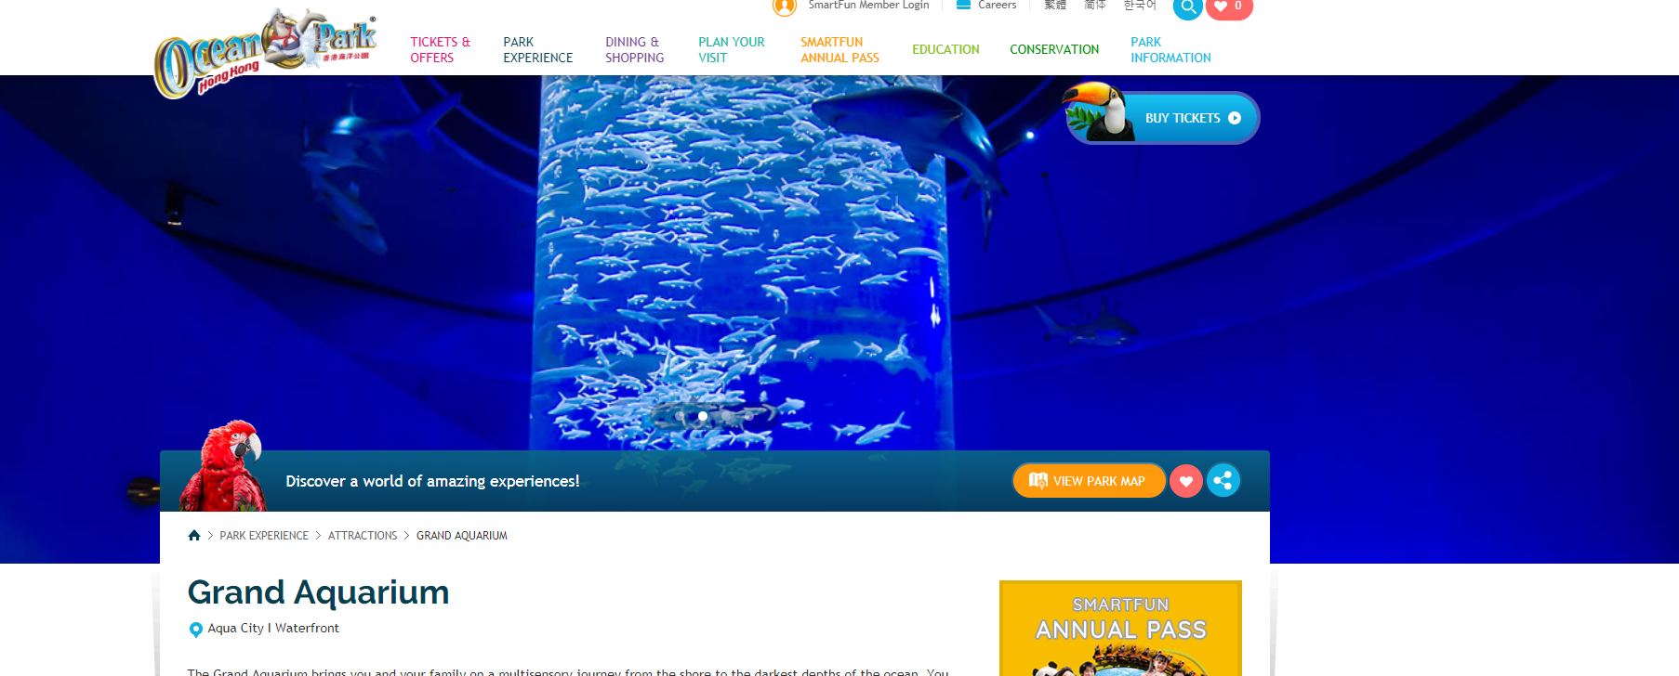
Aqua City I Waterfront The Grand Aquarium brings you and your family on a multisensory journey from the shore to the darkest depths of the ocean. You will have the exciting opportunity to explore the myriad forms of life that call the sea home, from a pool filled with sea cucumbers and starfish, to the spectacular Reef Tunnel, where you can view the profoundly beautiful ecosystem surrounding coral reefs. Expansive windows under the water like the 5.5m aquarium dome and an awe-inspiring 13m wide acrylic viewing panel takes you closer to an eye-opening collection of 5,000 fish from over 400 species!

Slide 3
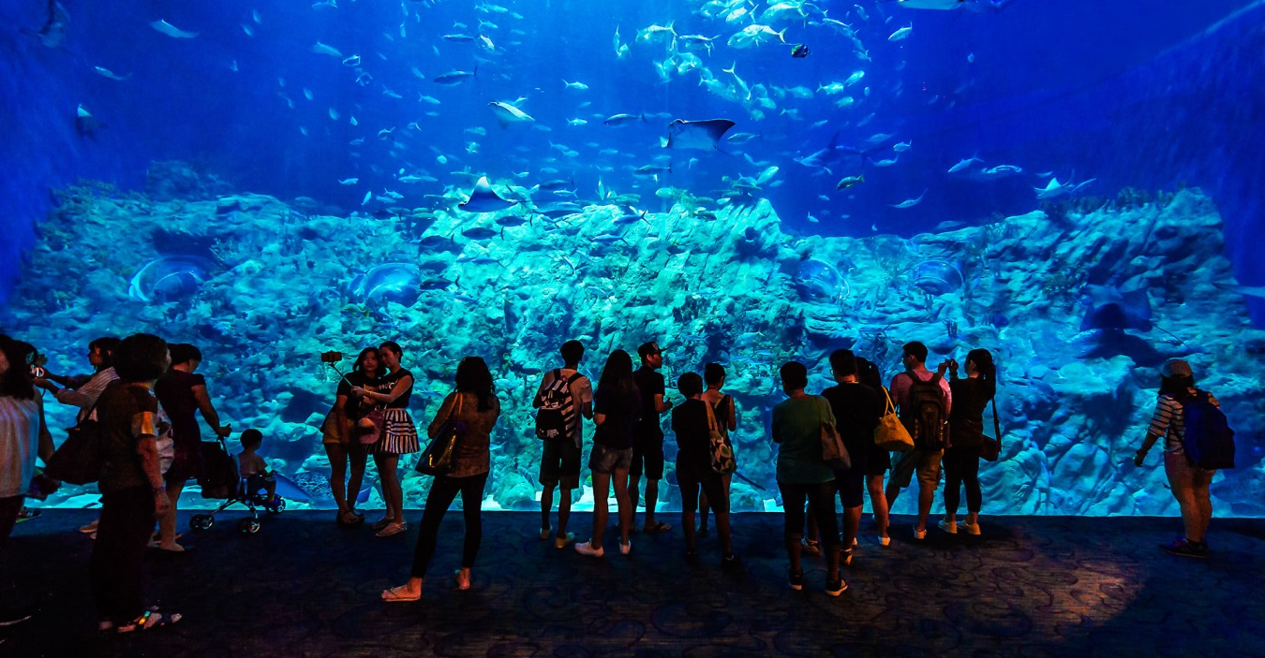
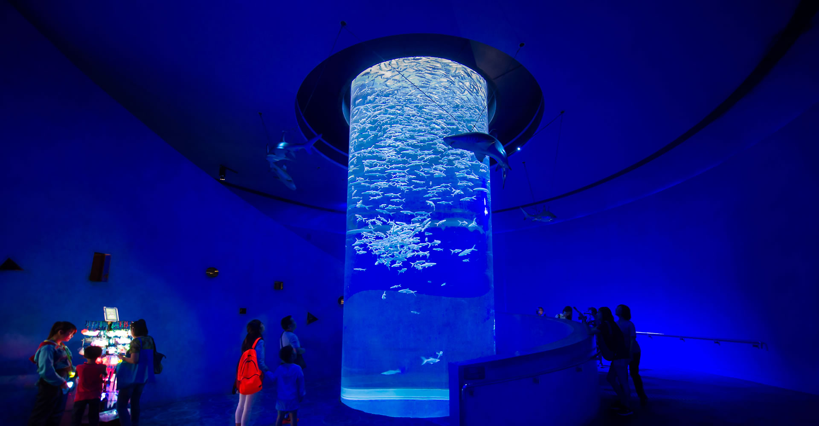
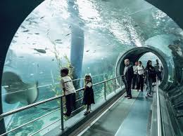

Slide 4
